Slide 1


Reseach and analysis on blockchain security Group – 50
Guide – Dr Subhash Chandra

Slide 2
Team Memebers
Dudam Sahihithi – 19BCY10164
Addanki Sreekar – 20BCY10127
Abhijay – 20BCY10084
Lokavardan – 20BCY10085

Slide 3
Existing work and its limitations
Block chain is used in cryptocurrency for noting the details of tractions between two buyers
Block chain is also used in private companies
Limitations
Key management
Scalability
3 Even Hackers can use it

Slide 4
Lack of awareness
Limited avalibilty of technical talent

Slide 5
Proposed work and methodology
Our team proposes
Blockchain knowledge should spread
Many private companies should use blockchain
Blockchain can change present security measures

Slide 6
Novelty of Project
Blockchain technology is not know to many people. So we researched on it and wrote code in python and made research papers where one person can understand what wonders can blockchain can do

Slide 7
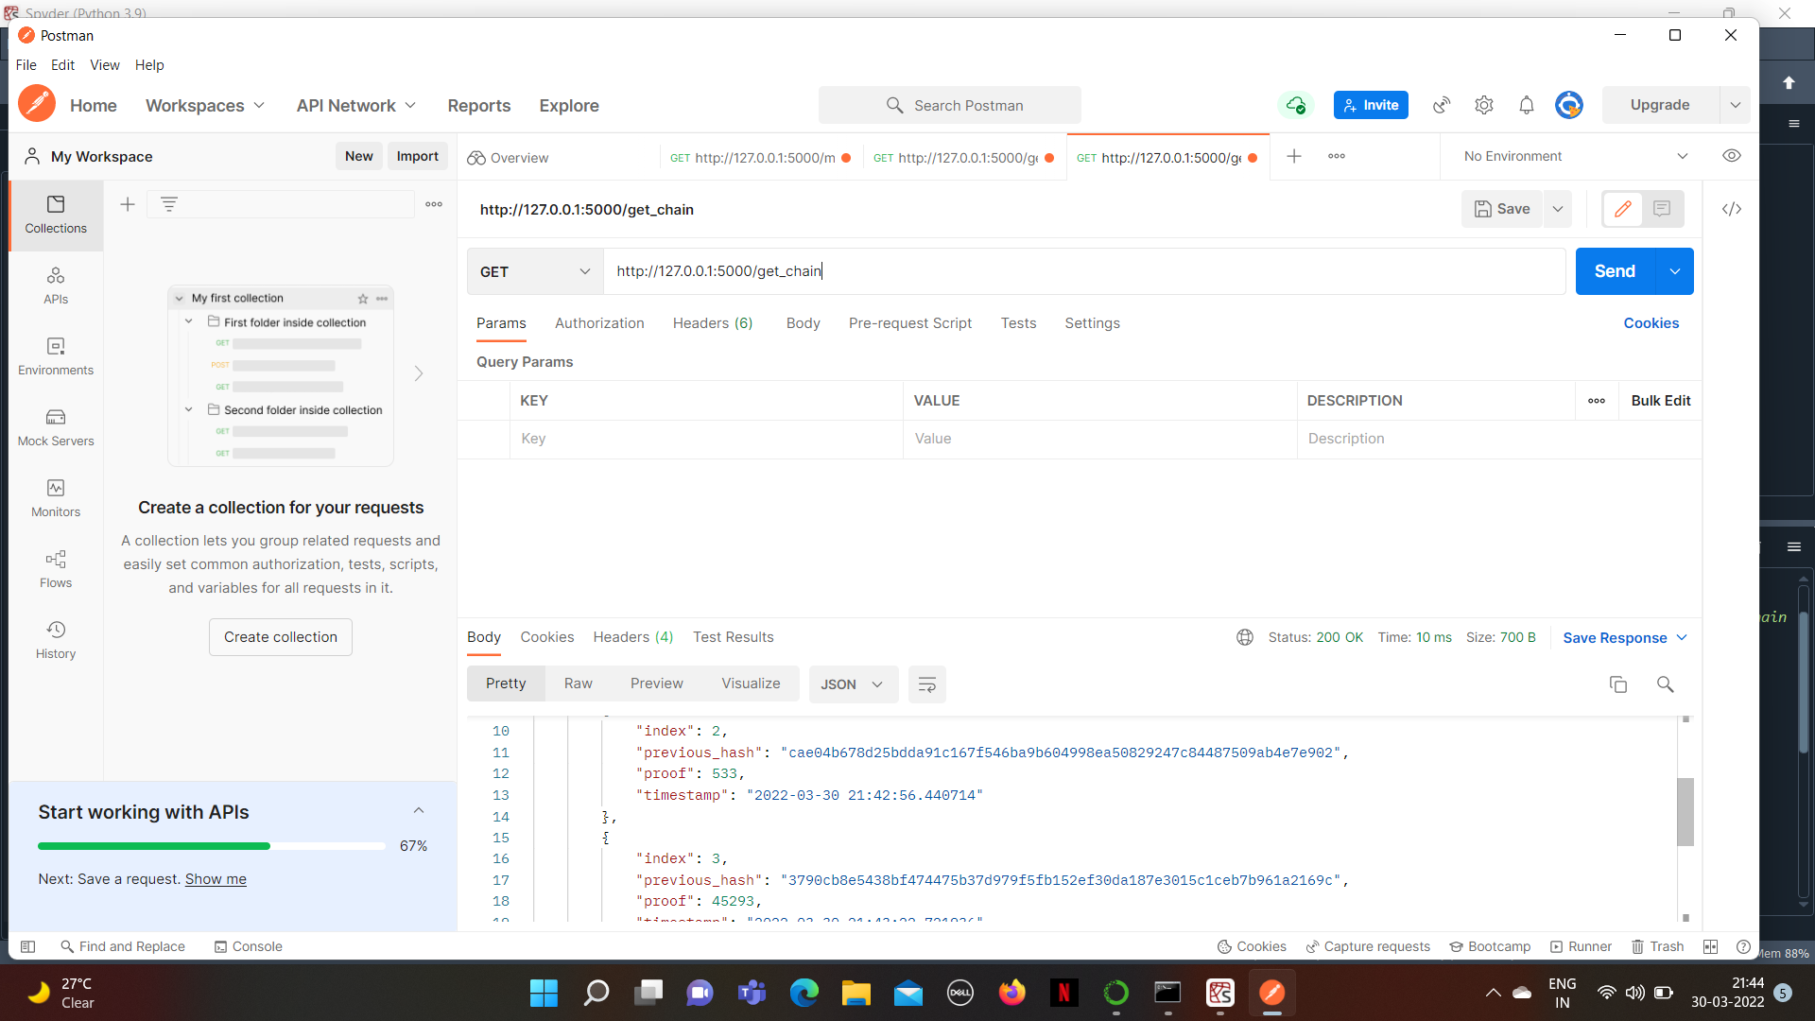
Real Time of Blockchain

Slide 8
Hardware and Software requirements
Operating System
CPU
RAM
Free disk space
In this project we used spyder to write the code and word for reseach paper

Slide 9
Overall system Architecture

Slide 10
We have researched about blockchain ,it include its history ,its uses and its security features
Review 2 – We have made a code using python of how a blockchain is made and test it using a API
Review 3 – We have made research paper of blockchain security

Slide 11
Literature Overview
Blockchain technology is a technology where it facilitiates a process the process of recording transactions and tracking assests in a business network
Blockchain technology can also be used In negative way

Slide 12
Module description

Slide 13
Module 1 – Introduction of blockchain
Module 2 – Blockchain security contains
Module 3 – How can we use blockchain and its limitations
Module 4 – Conclusion

Slide 14
Modules and its explanation

Slide 15
Module 1
Blockchain is widely for its use in Bitcoin
Blockchain is decentralised , transpercy , immutability
Blockchain is already used for tracking of assests of a company , voting services(some countries)
Blockchain can be public or private for a organization
The blockchain uses SHA encryption

Slide 16
Module 2
Blockchain consists of data , hash , previous hash
Blockchain security can be broken if there are less number of blocks but if it has thousands then hacking it will be difficuilt
Blockchain uses mechanism called smart contracts
There are different types of SHA that helps in encryption of block

Slide 17
Blockchain in easy words can be said as it is the timestamp that notes the entire transaction
Blockchain can be made easily but trying to change the contents can destroy the further blocks that have been already made
Blockchain hacking limitations are it takes a lot of time to hack (from days to years ) which makes it Safe

Slide 18
Module 3
Blockchain can be used in private companies for noting their finance where there assests are right now
Blockchain can be also used in voting system where Riging can be avoided
Blockchain can be used in securing personal information

Slide 19
Module 4
Blockchain can be considered one of the safest security measures for securing data . Blockchain is always decentralised which makes it not relying on one password . So we can say that blockchain technology can be used in private companies where it can store data . The limitations of it is that can also be used in negative way where a criminal can also use for making crime , but now is the best time to use blockchain as much is not know to the world about it

Slide 20
Coding
This is the simple program we made using python which does not contain

Slide 21
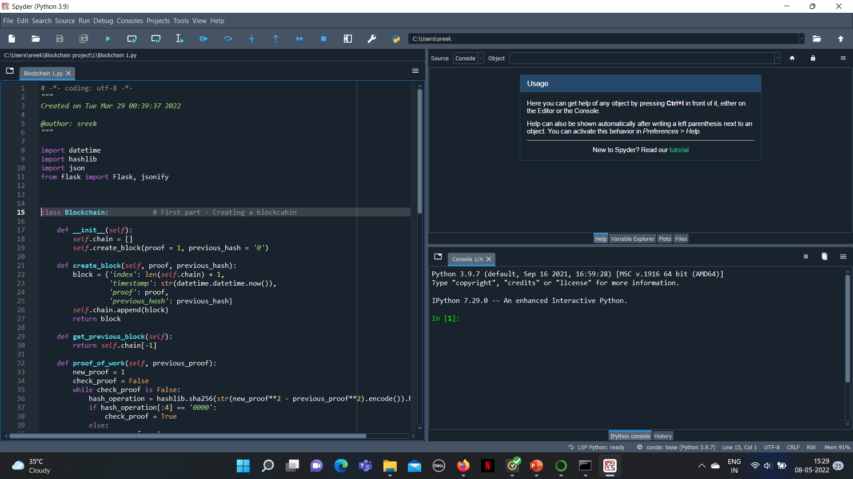

Slide 22
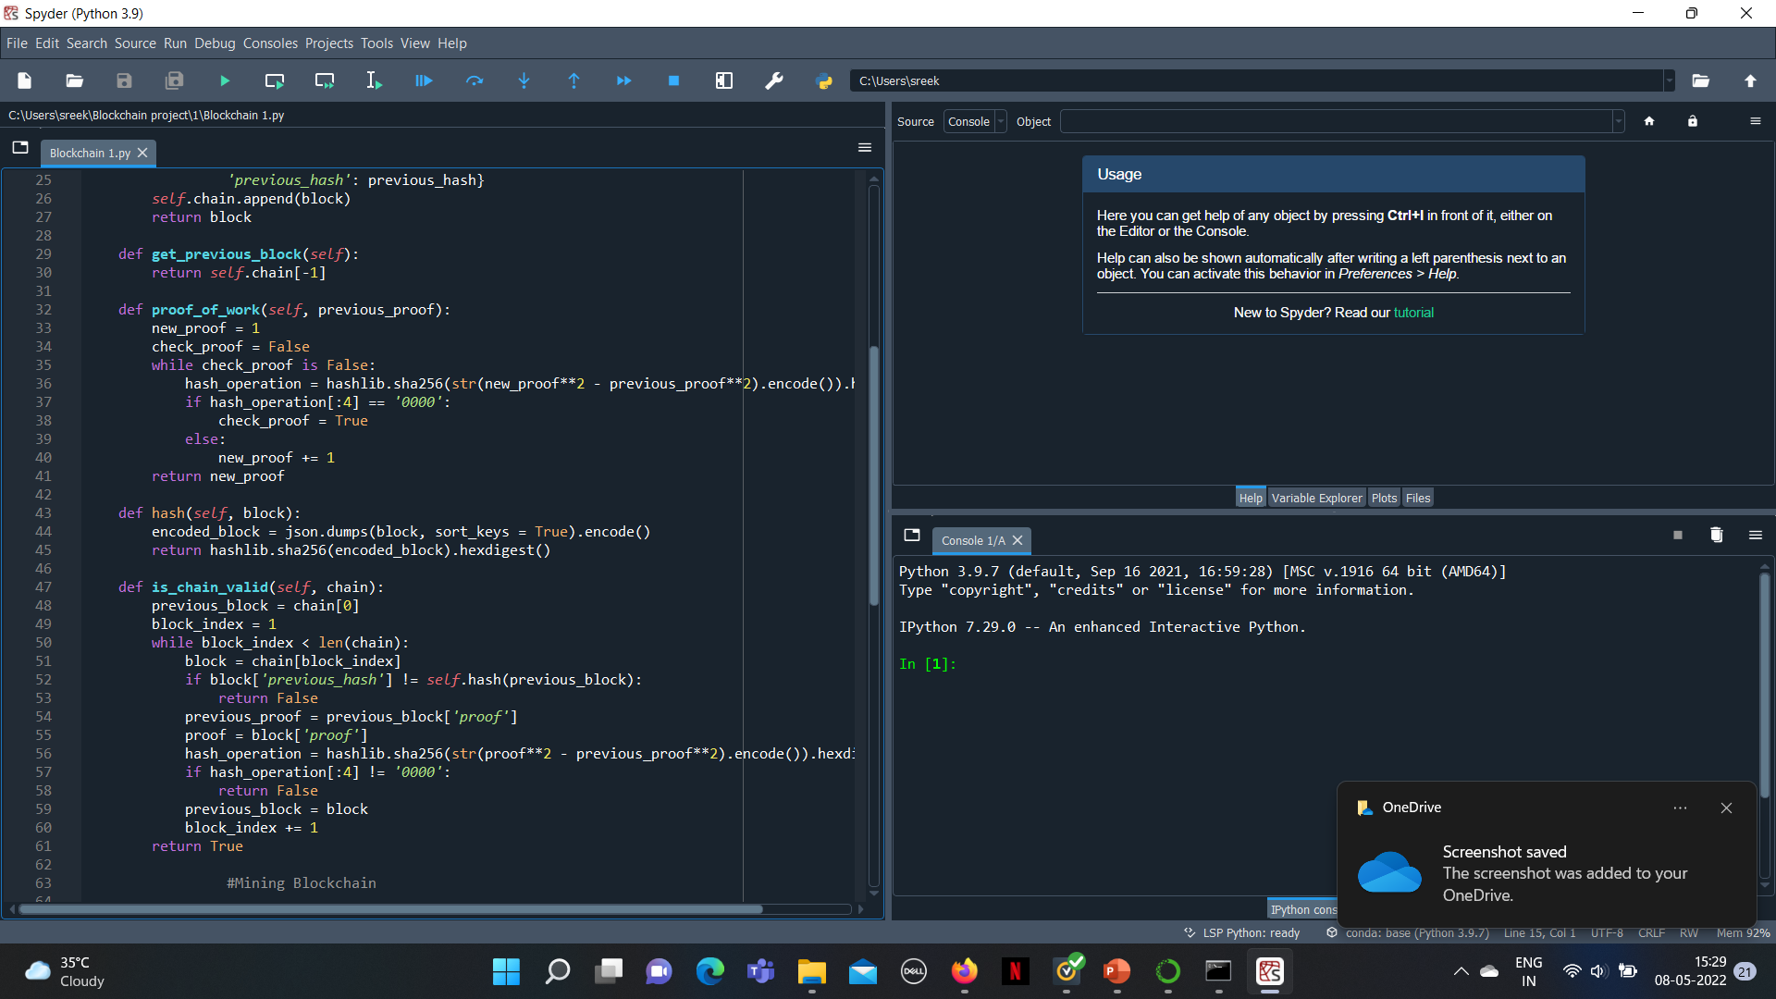

Slide 23
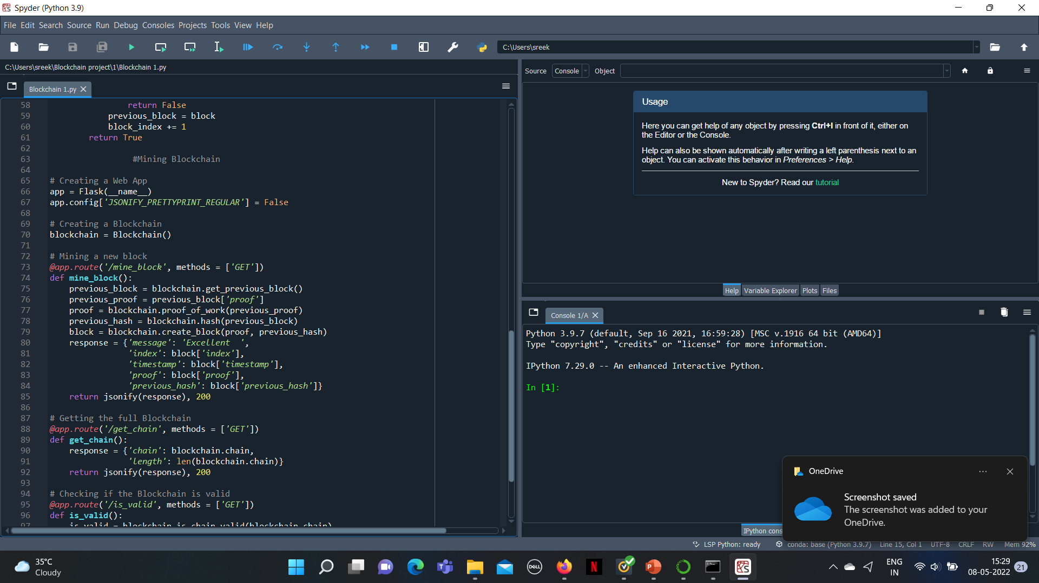

Slide 24
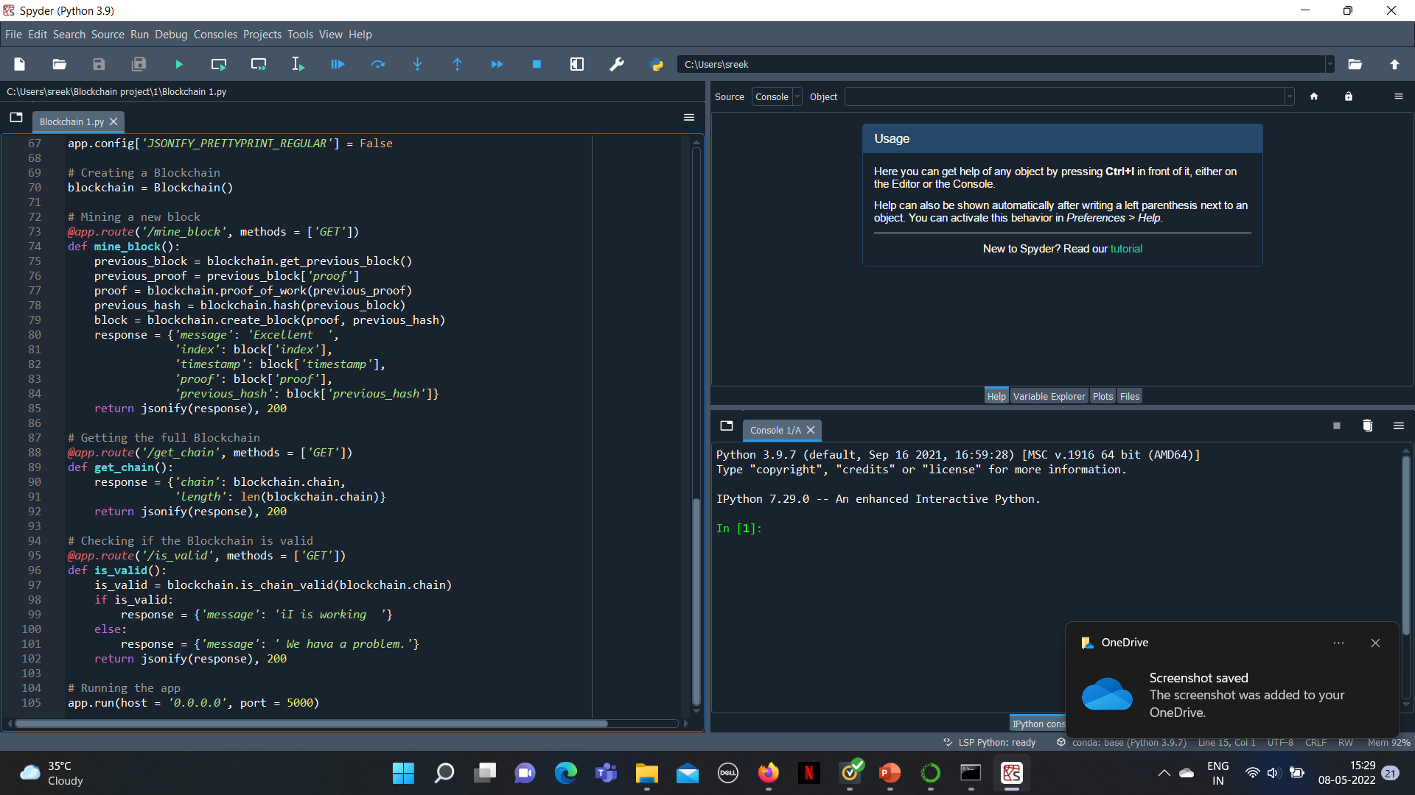

Slide 25
Snap chat of the the project

Slide 26
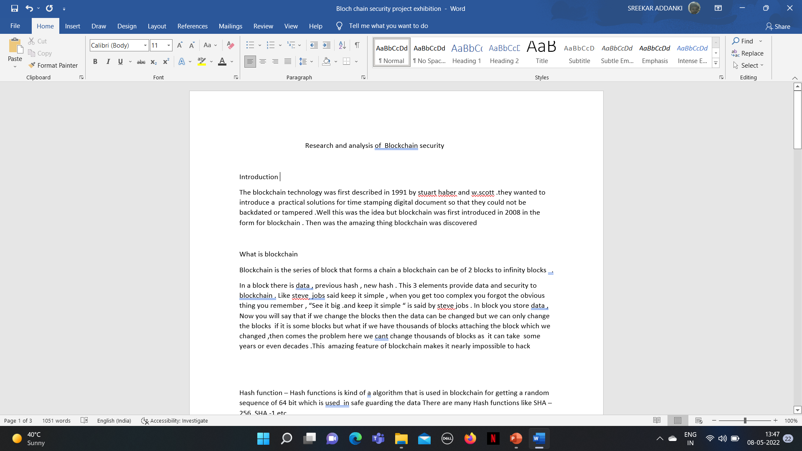

Slide 27
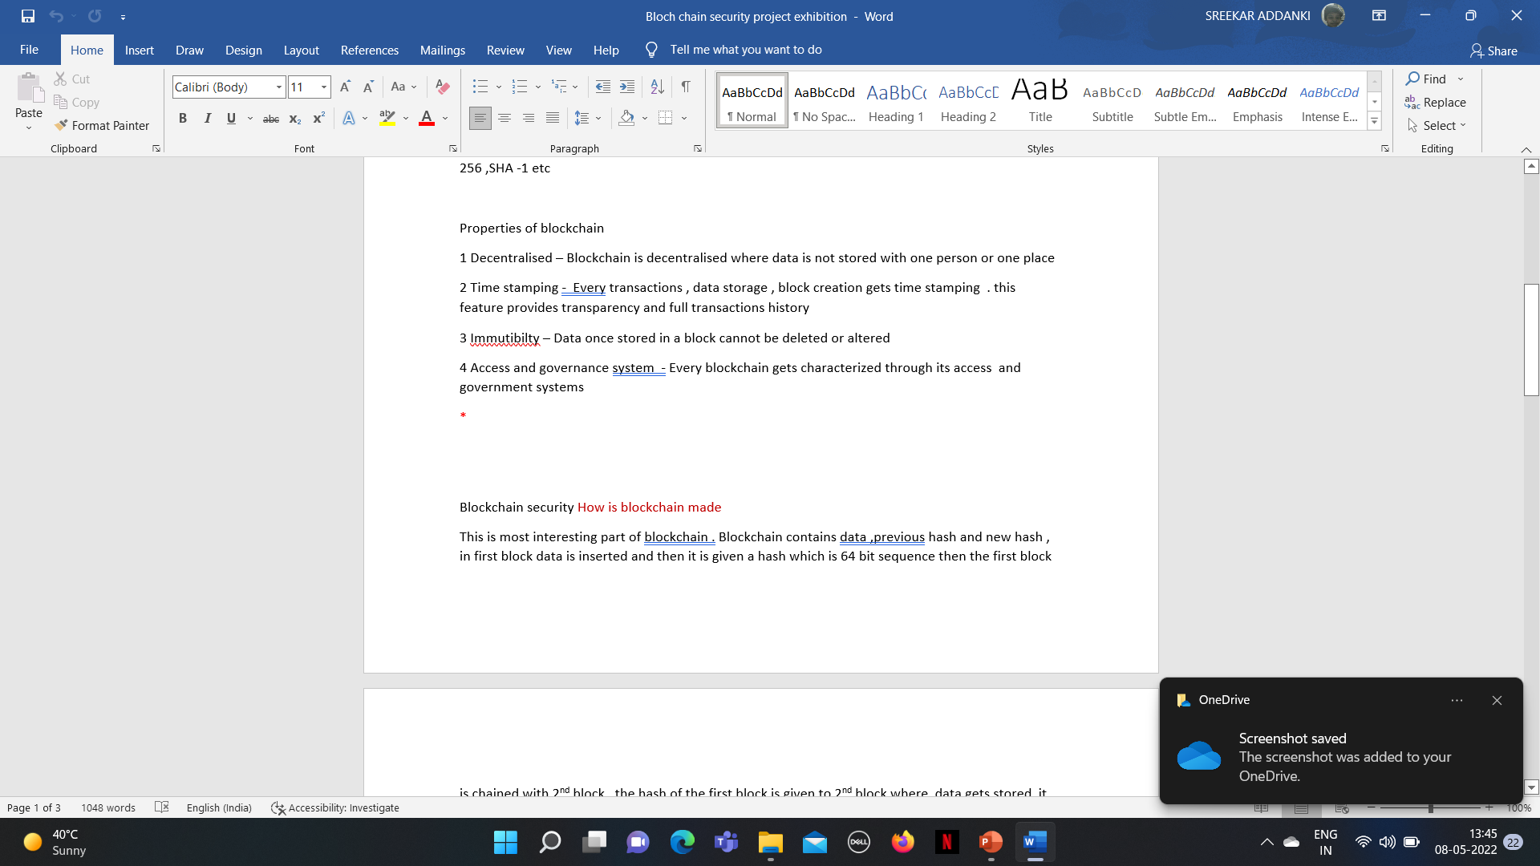

Slide 28
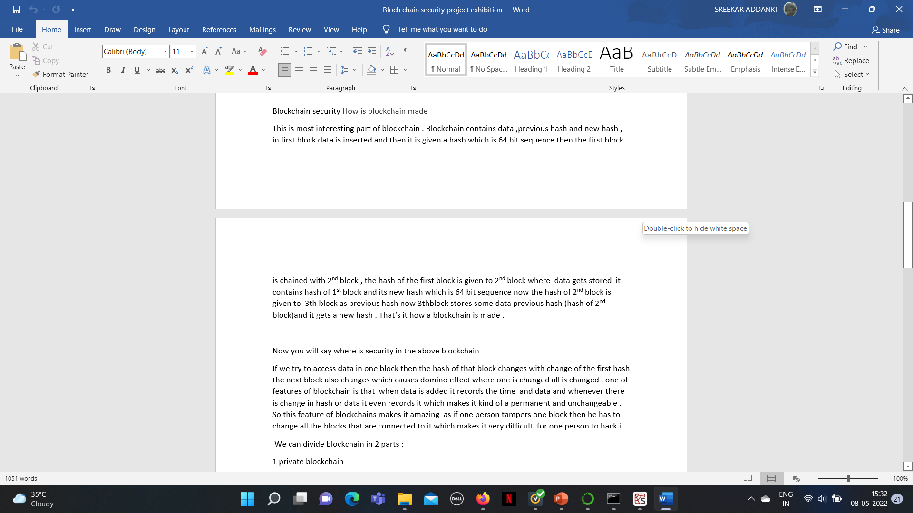

Slide 29
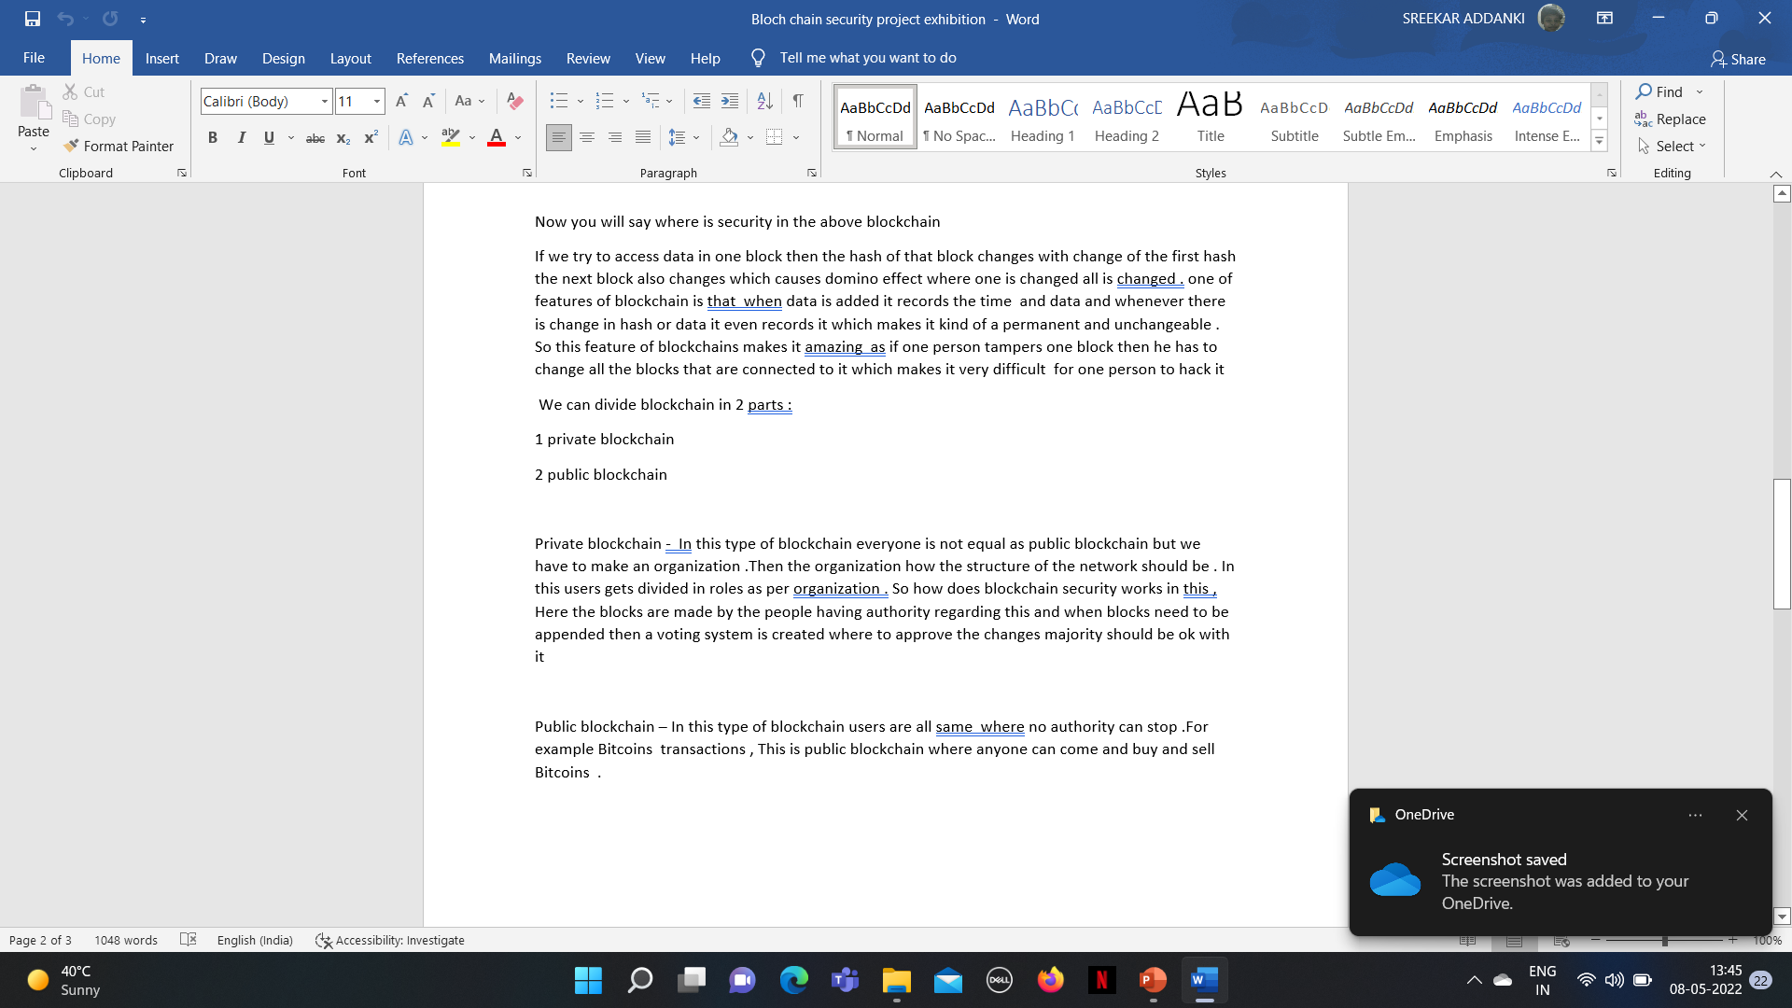

Slide 30


Slide 31
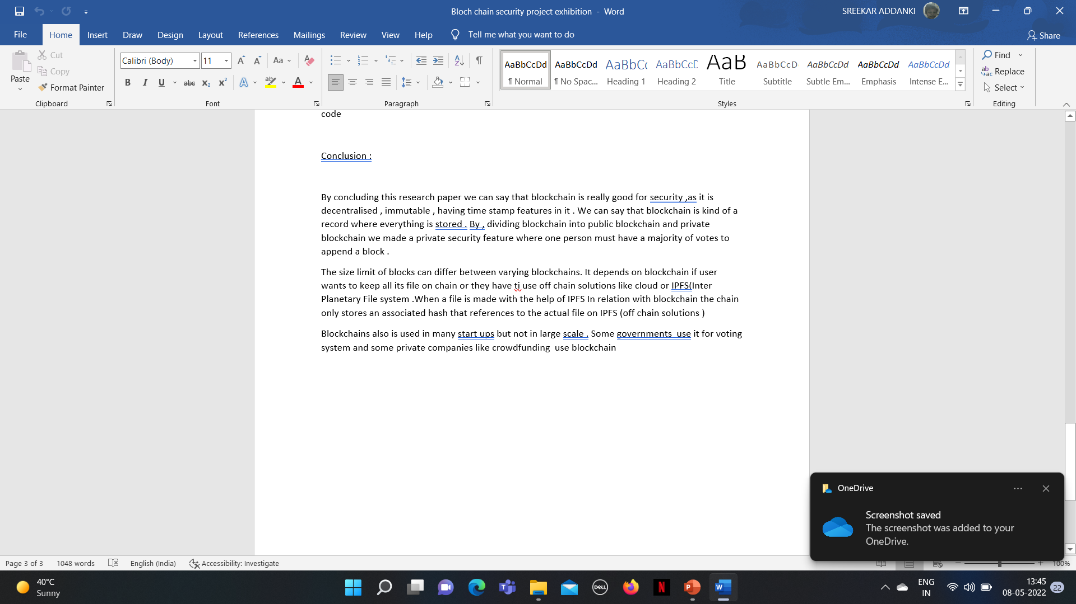

Slide 32
Conclusion
We can now conclude by saying blockchain is one of the best methods for security and blockchain technology must also be used in large scale

Slide 33
References
https://www.frontiersin.org/articles/10.3389/fbloc.2019.00016/full
https://www.techtarget.com/searchcio/definition/blockchain
https://www.researchgate.net/publication/318131748_An_Overview_of_Blockchain_Technology_Architecture_Consensus_and_Future_Trends
https://www.diva-portal.org/smash/get/diva2:1365314/FULLTEXT01.pdf
https://scet.berkeley.edu/wp-content/uploads/BlockchainPaper.pdf

Slide 34
Thank you

